Slide 1
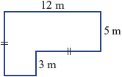

Topic: Measurement
EQ: How do we calculate the area of shapes?
Get your VIVO’s
Topic and EQ in Interactive Notebook
NO PHONES OR EAR BUDS
Have a go:
Question 1: Find the perimeter of each of the following shapes.
Question 2: Jennifer needs to fence her country house block to keep her dog in. The block is a rectangle with length 50 m and width 42 m. Fencing costs $13 per metre. What will be the total cost of fencing?

Slide 2
Lesson OBJECTIVE:
By the end of the lesson you should have:
Added a variety of shape formulas to your notes
Increased your current understanding of area in regards to rectangles, triangles and squares.

Slide 3
24
7
30
Date
Measurement
EQ: How do we calculate the area of shapes?
What is perimeter:
.
Perimeter is the border around a shape. An example of this would be the fence around BSC

Slide 4

24
7
30
Date
Measurement
EQ: How do we calculate the area of shapes?
Area is the size of a surface. The amount of space inside the boundary of a flat, 2-dimensional object.
This is a conversion chart. You must always make sure your units of measurement are

Slide 5
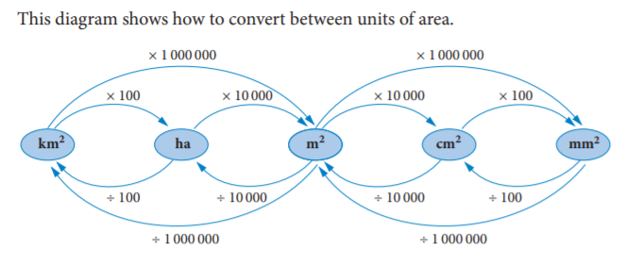
24
7
30
Date
Measurement
EQ: How do we calculate the area of shapes?
This is linear conversion. AREA CONVERSION IS THIS

Slide 6
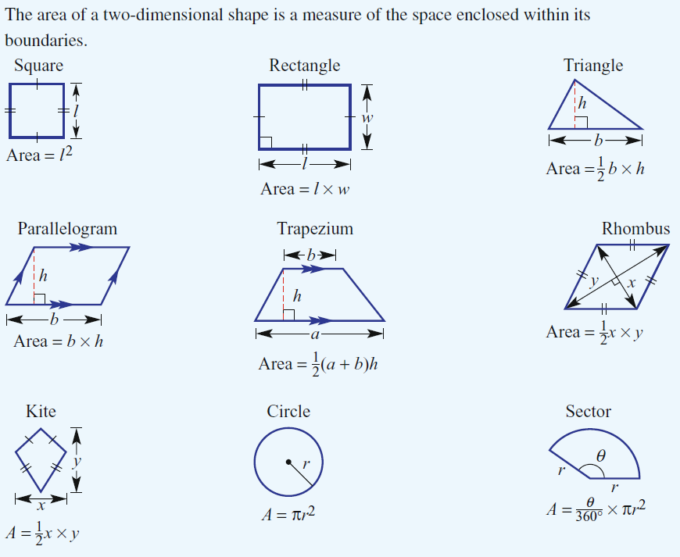
Basic Shape Formulas
Notes:
See worksheets PPT to print this slide for students

Slide 7
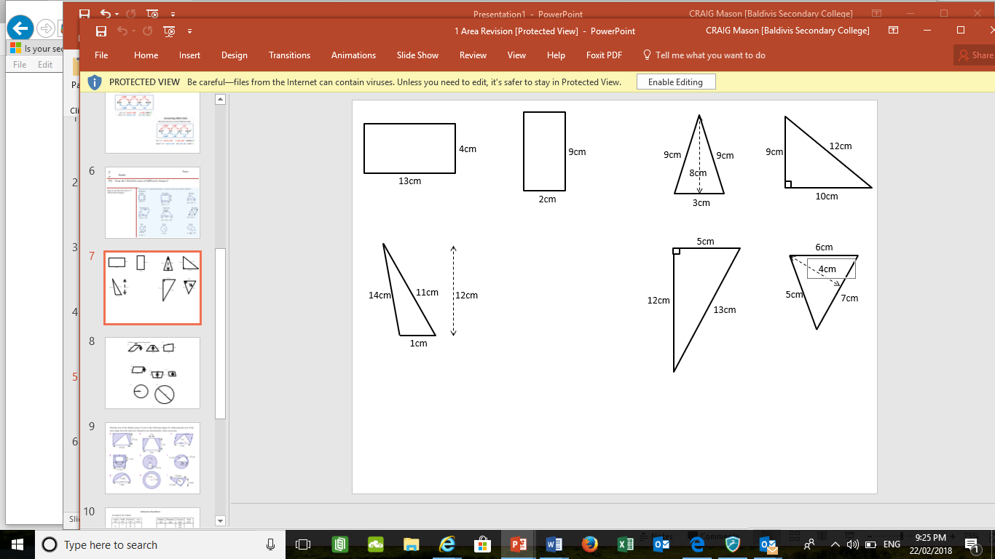
Rectangles and Triangles Find the area of the following .

Slide 8
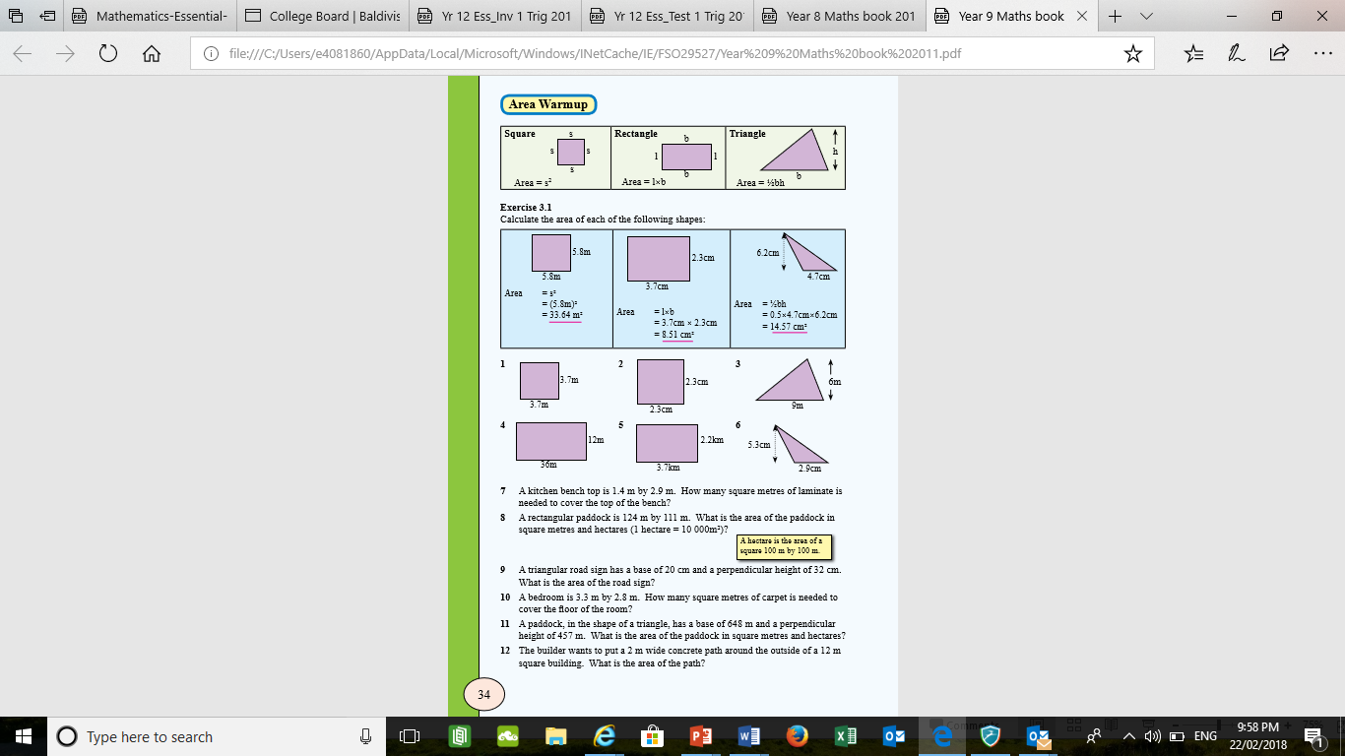
More Practice finding the area
Notes:
See worksheets PPT to print this slide for students

Slide 9

To conclude: If you answered/attempted the work….

